Slide 1
American Revolution Battle Chart Key

Slide 2
Bunker Hill
Date-June 17, 1775
Location- Breed’s Hill outside of Boston, MA
Winner-British
Main Ideas
  Part of the Siege of Boston
  It took the British three assaults to take the hill
Impact
  British suffer heavy losses
  Proved that the inexperienced American troops were willing to stand up to the British

Slide 3
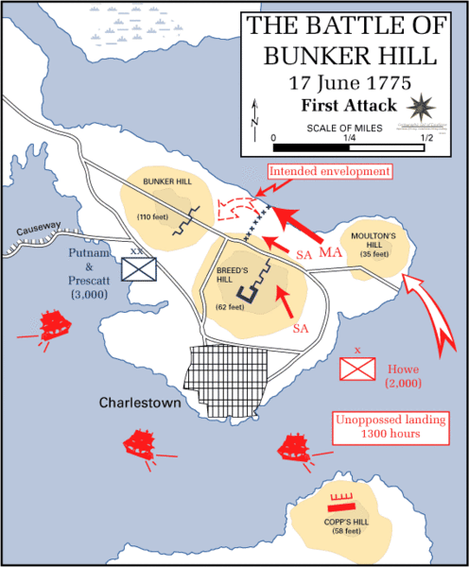

Slide 4
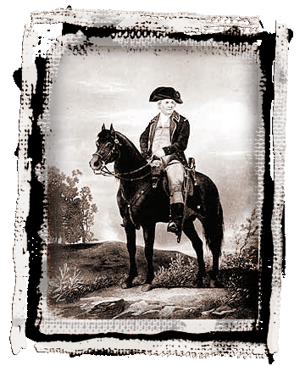
Bunker Hill Famous Quote
“Don’t fire until you see
the whites of their eyes.”
  —Israel Putnam
  American Army General
Notes:
The battle on Bunker Hill was furiously violent. The quote “Don’t fire until you see the whites of their eyes” is often attributed to Israel Putnam, but sources are not completely in agreement. Regardless of who actually spoke the words, they have gone on to symbolize any soldier who is calm in the face of a seemingly insurmountable enemy.

Slide 5
Trenton
Date- morning of December 26, 1776
Location- Trenton, NJ
Winner - Americans
Main Ideas
  Washington lead Army across the Delaware River and surprised the Hessians
  nearly the entire Hessian force was captured, with negligible losses to the Americans
Impact
  Significantly boosted the Continental Army's morale and inspired reenlistments

Slide 6
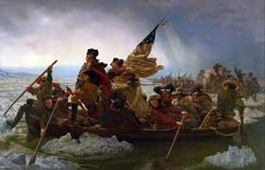

Slide 7
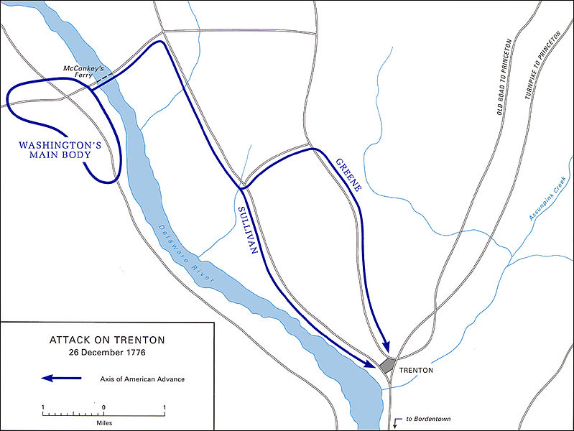

Slide 8
Saratoga
Date- 9/17 & 10/7 (the surrender was 10/17) 1777
Location- Saratoga, NY
Winner-Americans
Main Idea-
  British tried to divide New England from the Southern colonies
  After two days of battle, 18 days apart, Burgoyne was force to surrender
Impact
  The British are unable to divide NE from the Southern colonies
  Instrumental in formally bringing France into the war as an American ally

Slide 9
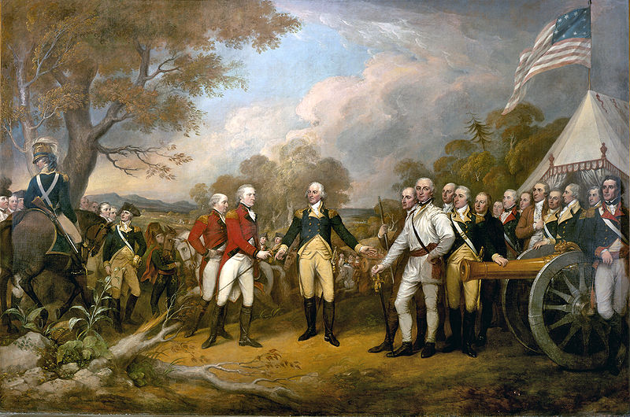

Slide 10
King’s Mountain
Date- 10/7/1780
Location- Not far from King’s Mountain (York County, SC)
Winner- Americans
Main Ideas-
  The Overmountain Men completely surprised a group of Tories led by British Major Patrick Ferguson
  The Patriot forces offered the Tories no quarter
Impact-
  greatly raised the Patriots' morale
  Cornwallis was forced to abandon his plan to invade North Carolina and retreated into South Carolina

Slide 11
Cowpen’s
Date- January 17, 1781
Location- Hannah’s Cowpens, SC
Winner- Americans
Main Ideas
Summary
  One of the biggest defeats of the War for the British
  Daniel Morgan tricks Banastre Tarleton
Impact
  Americans captured many of the best British soldiers

Slide 12
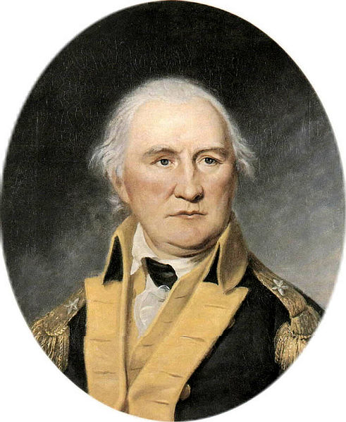
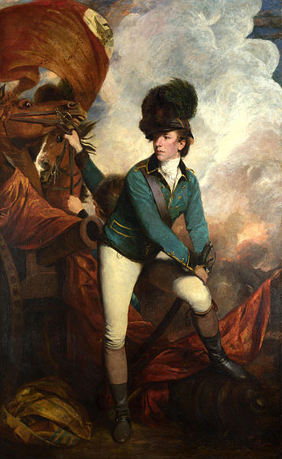

Slide 13
Guilford Courthouse
Date- March 15, 1781
Location- Guilford Courthouse, NC
Winner- British
Main Ideas
  Some of the fiercest fighting of the War
  Cornwallis fired grape shot into a spot where some of his own men were fighting the Americans
Impact
  British lost a quarter of their men

Slide 14
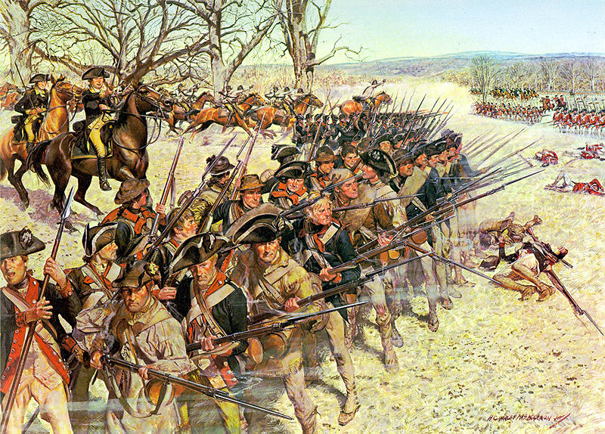

Slide 15
Yorktown
Date – 10/19/1781
Location- Yorktown, VA
Winner- Americans
Main Idea
  Cornwallis is surrounded
    Washington from the North
    Greene from the South
    France from the Atlantic Ocean
Impact
  The war ends
  American Independence

